Slide 1



Dip in 6
Lesson 23
Association game

Slide 2
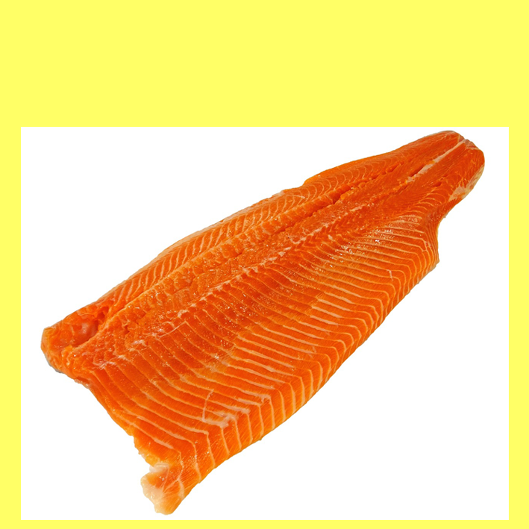
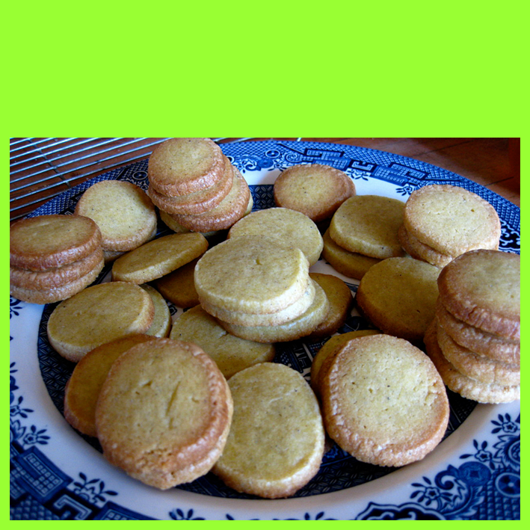
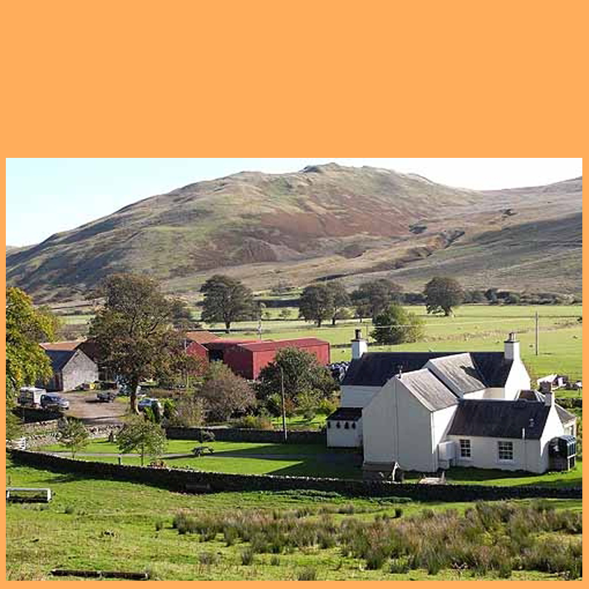
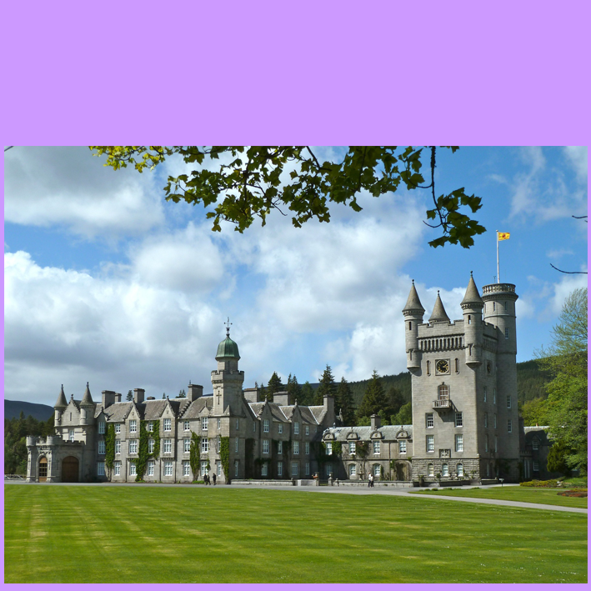

A1
fish
B1
biscuits
C1
in the country
D1
large buildings
pink flesh
flour
houses
A2
B2
C2
D2
beautiful
smoked
sugar
animals
kings & queens
A3
B3
C3
D3
A4
seas & rivers
B4
butter
C4
fields
knights
D4
COLUMN A
COLUMN C
SALMON
COLUMN B
FARM(S)
SHORTBREAD
CASTLE(S)
COLUMN D
THE FINAL ANSWER
SCOTLAND

